Slide 1
Azure DevOps Users Auditor

Slide 2

Agenda
Problem statement
Solution overview
Business plan
Architecture/diagrams
SWOT
Resources
Idea / approach
Opportunity description

Slide 3
How and Why?
There are thousands of customers who use Azure DevOps in their organization for different type of project managements tasks.
Both technical and business-oriented users consume many functionalities and capabilities of DevOps
Planning and Tracking
One Stop Dashboards
CICD
Source Control
Documentation/Wiki
Test Plans
So, a lot of good stuff and functionalities in just one offering, right? And, as per the saying, “Nothing good in this world comes free! For everything there is an associated cost.”
And then, we started our analysis on the costing associated to Azure DevOps Cost.

Slide 4
How and Why?
For many of customers, we have worked on DevOps hosted on clients’ environments.
In general, we don’t keep more focus on Azure DevOps cost and always prioritize costing associated to more technical Azure services like ADF, Databricks, SQL, Functions, etc.
Many services have either fixed monthly cost or pay-as-you-go setup. But, what about the monthly subscribed cost and those situations where there is no usage but still, we are paying monthly cost because we have subscribed for it?
After quick analysis on multiple projects, we have observed the importance of a simple application which can save thousands of dollars for organizations with significant users working on Azure DevOps.

Slide 5
Problem Statement
Companies are bearing unnecessary costs for their Azure DevOps accounts/ organizations.
Solution:
Build an application which can
Perform systematic analysis of current Azure DevOps users and their licenses with the help of Power BI visualizations.
Helps in making decisions to change users' licenses who have not accessed DevOps since longer period and save cost.
Provides predictive analysis of users and respective Azure DevOps cost with time.

Slide 6
Pricing for Azure DevOps
Azure DevOps Services
User Licenses
Basic Plan ($6 /user/month) (first 5 users free)
Basic + Test Plan ($52 /user/month)
Individual Services
Azure Pipelines (First pipeline is free for both Self and Microsoft hosted)
Microsoft-hosted CI/CD - $40 per pipeline (parallel job with 1,800 minutes per month for CI/CD).
Free Self-hosted CI/CD - $15 per pipeline (parallel job with unlimited minutes).
Azure Artifacts - 2 GiB free , then starting at $2 per GiB.
Azure DevOps Servers (Visual Studio Subscriptions)
Visual Studio Professional - $45 /user/month
Visual Studio Enterprise - $250 /user/month

Slide 7
Billing for Azure DevOps
With user general-based billing, we only pay for the users we assign an access level. When we remove the users, charges stop. There's no longer an extra step of increase/decreasing the paid count. Also, billing for any user starts only after that user access DevOps.
We can check our DevOps cost from Azure portal
Subscriptions -> Cost Analysis -> Service Name=“Azure DevOps”
Some Important Q/As
What if a user is assigned Basic in one organization and Basic + Test Plans in another?
They're billed for both Basic and Basic + Test Plans, which is a current limitation of multi-organization billing. We recommend assigning users with group rules and setting up the same group rules in each organization to ensure consistent access level assignment.
What is multi-organization billing?
It allows you to pay once per user, for organizations under the same Azure billing subscription.

Slide 8
Business Case
In general, we have seen there are 30-40% users in every company who have not used Azure DevOps in past few months, but companies are still bearing costs associated to those licenses.
This redundant cost can be huge and can be thousands of dollars per month for big customers. We can target those customers and help them to save millions a year.

Slide 9



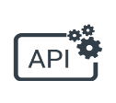






Architecture and Process Flow
Azure DevOps
HTTP Trigger
HTTP Trigger
Web App
Storage Account
Web App with Embedded PBI
HTTP Trigger
Model
Azure Subscription

Slide 10
Features and Benefits
Cost effective and a simple solution with a huge impact on savings
Customers can perform analysis on their Azure DevOps account with wide variety of metrics like
Total users with different licenses
Total active users for whom customer is getting charged on Azure
Estimated cost based on active licenses
Actual cost associated to active users from their Azure Subscription
Predicted users and cost after 6 months as per historic trends
And many more…
With the help of Forecast model in advance we got an idea about how many accounts will be created in future and how much cost we will spending on DevOps licenses.
Administrator doesn’t have to manually check and figure out gaps which are causing huge amount of unnecessary costs. Specially for big organizations having huge userbase.
Administrator can filter out users who haven’t accessed Azure DevOps from longer time and move the paid licenses to Stakeholder.

Slide 11
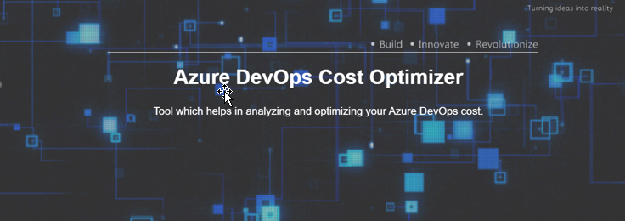
Demo

Slide 12
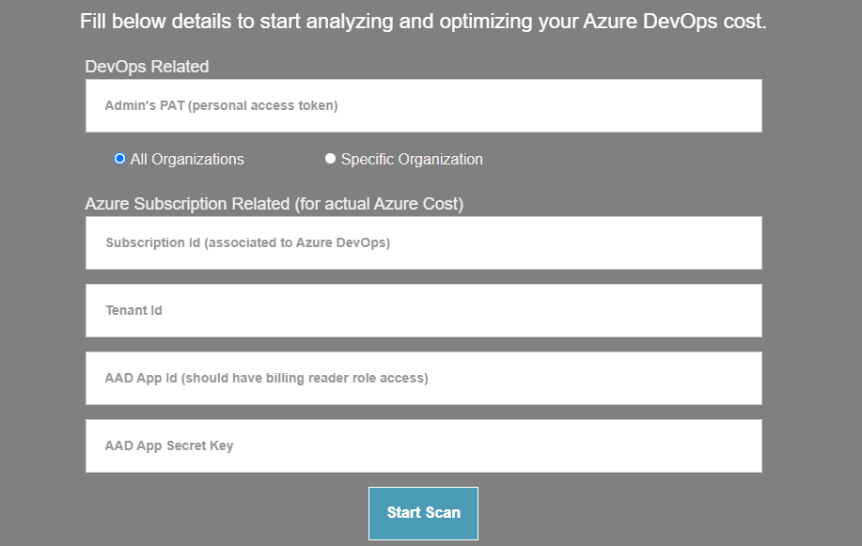
Demo

Slide 13
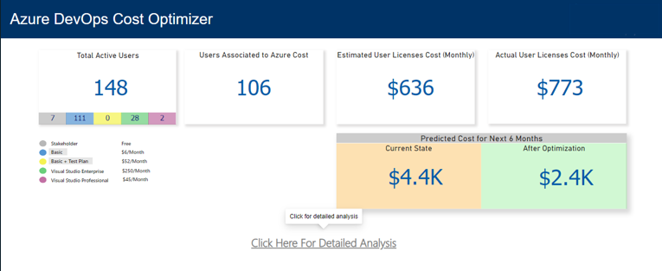
Demo

Slide 14
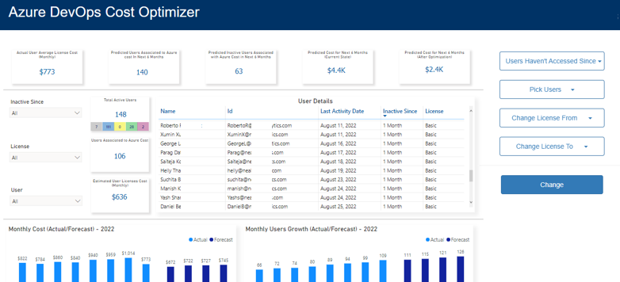
Demo

Slide 15
Business overview
Ideal Customer Profile (ICP)
Target industries: All
Company size: 500+ employees
Target Business Processes: Technical
Personas within target: Business owners
We have fetched actual insights related to DevOps licenses associated to Azure Subscription cost and following are some of our target companies with maximum consumption.
PROCTER & GAMBLE COMPANY
KTM Industries AG
KROGER CO
INDUSTRIELLE ALLIANCE
ROLLS-ROYCE PLC
NATIONAL BASKETBALL ASSOCIATION
DELOITTE & TOUCHEEY GLOBAL SERVICES LIMITED
GOVERNMENT OF ONTARIO
INFOCORP URUGUAY
SASOL SOUTH AFRICA LTD

Slide 16
SWOT
Internal factors
External factors
Optimizing cost for DevOps in efficient manner
Provide recommendations to save billing cost within app
Predictive analysis for users
Predictive analysis for billing w/o optimization
Easy to setup with few pre-requisites
Lightweight and cost efficient
Solution can be implemented for any industry/company
Positive
Partial/incomplete analysis in case of multiple organizations
Perform recommended actions from within app
Include analysis for Azure Pipelines and Artifacts also
Being as Microsoft partner, solution will reduce the billing usage from their customers
Processes exists in market with similar end goal
Negative

Slide 17
Next Phases and Plans
Make our tool properly capable enough to perform recommended actions like removing user, changing license level for a user etc.
Provide analysis for Azure pipelines and artifacts also to give better recommendation for saving overall billing cost.
Improve the capabilities of solution to handle more scenarios like multi-organization analysis.
Analysis on Azure DevOps Server associated licenses and their usage to save further costing.
Make our tool capable enough to perform analysis and optimizations for multiple customers simultaneously.

Slide 18
Resources
https://azure.microsoft.com/en-us/pricing/details/devops/azure-devops-services/
https://docs.microsoft.com/en-us/rest/api/power-bi/datasets/refresh-dataset
https://docs.microsoft.com/en-us/rest/api/cost-management/
https://docs.microsoft.com/en-us/rest/api/azure/devops/memberentitlementmanagement/user-entitlements/list?view=azure-devops-rest-4.1&tabs=HTTP
https://docs.microsoft.com/en-us/rest/api/azure/devops/account/accounts/list?view=azure-devops-rest-7.1&tabs=HTTP

